Slide 1

Predicting calorie expenditure
Elliot Blackstone
eblackst@umich.com
https://github.com/ElliotBlackstone
Notes:
The objective of this project is to predict the calories burned during a workout.

Slide 2
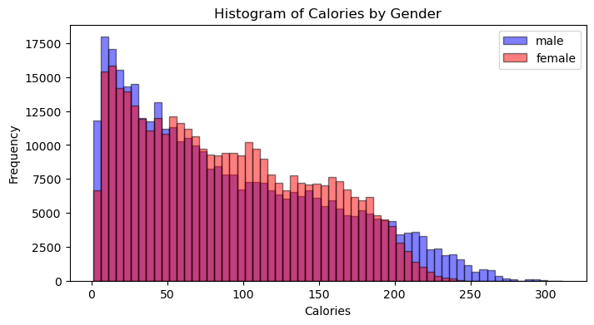

DATASET
Training set has 750,000 rows and 9 columns:
Duration
Heart Rate
Gender
Body Temperature
Height
Weight
Age
id
Calories (target)
Testing set has 250,000 entries. The objective is to minimize root mean squared log error (RMSLE).
Notes:
The dataset is provided by the Kaggle competition “Predicting Calorie Expenditure”.
The training set has 750,000 rows, 8 features (duration, heart rate, gender, body temperature, height, weight, age, id) and the target calories.
There is an even split between men and women, and in the histogram we can see the calories burned, colored by gender.
The testing set has 250,000.
The objective is to minimize the root mean squared log error on the testing dataset.

Slide 3

Preprocessing, feature engineering
Preprocessing is comprised of the following steps:
Log transform calories
One-hot encoding for gender
Delete id column
Change columns height, weight, duration, heart rate from float to int
This reduces file size by 10.5%!
For feature engineering, we add:
Body mass index (BMI)
Interaction terms for numerical features
Body temperature squared
Notes:
Preprocessing is comprised of the following steps:
Calories is log transformed
Male/female is one-hot encoded
The id column is essentially an index and can be deleted
Features height, weight, duration, heart rate, which are all integers, are switched from type float to type int.
These steps reduce file size by 10.5%!
For feature engineering, we add body mass index, interaction terms for all numerical features, and body temperature squared.

Slide 4
Model performance
Model | Feature Engineering | RMSLE | LB (out of 4318)
Linear Regression | No | 0.17926 | 4025
Linear Regression | Yes | 0.09431 | 3826
GAM | No | 0.08945 | 3811
GAM | Yes | 0.06949 | 3605
XGBoost | Yes | 0.05922 | 1324
LightGBM | Yes | 0.05921 | 1314
CatBoost | Yes | 0.05903 | 1050
Ensemble | N/A | 0.05879 | 678
AutoGluon | No | 0.05846 | 4
Notes:
We can compare the effectiveness of our models with the Kaggle leaderboard for this competition, which had 4,318 teams submit predictions. (*click*)
Two linear regression and generalized additive models were trained with and without feature engineering. These models don’t score competitively, but we can see that FE significantly improves RMSLE for both models. (*click*)
Next, three models based on gradient boosted decision trees were trained. (*click*)
The XGBoost, LightGBM, and CatBoost models were all trained with FE and hyperparameter tuning was done via Optuna. These models begin to score competitively with the CatBoost model getting into the top 25% of the leaderboard. (*click*)
To further improve, these three models were ensembled. (*click*)
The best model trained is an AutoGluon model with no feature engineering. With a RMSLE score of 0.05846, it ties for 4th place out of 4318 teams.

Slide 5

Model performance
Model
Feature Engineering
RMSLE
LB (out of 4318)
Linear Regression
No
0.17926
4025
Linear Regression
Yes
0.09431
3826
GAM
No
0.08945
3811
GAM
Yes
0.06949
3605
XGBoost
Yes
0.05922
1324
LightGBM
Yes
0.05921
1314
CatBoost
Yes
0.05903
1050
Ensemble
N/A
0.05879
678
AutoGluon
No
0.05846
4
Notes:
We can compare the effectiveness of our models with the Kaggle leaderboard for this competition, which had 4,318 teams submit predictions. (*click*)
Two linear regression and generalized additive models were trained with and without feature engineering. These models don’t score competitively, but we can see that FE significantly improves RMSLE for both models. (*click*)
Next, three models based on gradient boosted decision trees were trained. (*click*)
The XGBoost, LightGBM, and CatBoost models were all trained with FE and hyperparameter tuning was done via Optuna. These models begin to score competitively with the CatBoost model getting into the top 25% of the leaderboard. (*click*)
To further improve, these three models were ensembled. (*click*)
The best model trained is an AutoGluon model with no feature engineering. With a RMSLE score of 0.05846, it ties for 4th place out of 4318 teams.

Slide 6
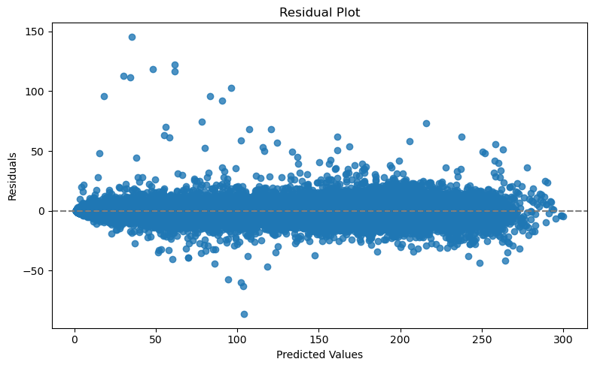

AUTOGLUON MODEL
AutoGluon trained 91 different models. The top performing model is a stacked ensemble of
3 CatBoost,
4 XGBoost,
2 ExtraTrees,
2 RandomForest,
3 NeuralNet,
2 LightGBM.
This model is the simplest of all the top performing models on Kaggle!
Notes:
AutoGluon trains many different machine learning based models, and stacked ensembles of those models, then choose the best.
With 16 hours of training time, it produced 91 different models, with the top performing model being a stacked ensemble of various CatBoost, XGBoost, LightGBM, RandomForest, ExtraTrees, and NeuralNet models.
We can see from the residual plot on a holdout set with 150,000 entries that this model does quite a good job.
All the top scores on Kaggle were achieved by using ensembles, many of which ensembled AutoGluon with many other models. In that regard, this single AutoGluon model is the simplest out of all the top performing models for this Kaggle competition.

Slide 7
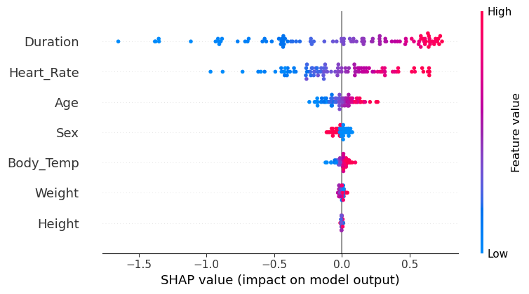

Explainability
How to understand the contributions of each feature towards a prediction made by a machine learning model? We can use SHAP values!
Notes:
With “black box” models, such as AutoGluon, it is important to understand how the model values each feature when making a prediction.
To better understand our models, we can use the package SHAP (Shapley additive explanations).
In the beeswarm plot, we can see our features on the left, and the color represents the feature value, with blue being low and red being high.
The grey vertical line at 0 represents the mean predicted value of (log transformed) calorie expenditure.
Focusing on our most impactful feature, Duration, we see that low values of Duration cause the model to lower the predicted value, relative to the mean, and vice versa for high values of Duration.
We can see that the model believes height and weight have almost no impact on calorie expenditure, which aligns with intuition.
We can also use SHAP values for debugging.
For example, it might seem strange that the model believes higher Age will result in higher calorie expenditure. During EDA, it was noticed that age and calories has a slight positive correlation, so this unusual relation is a feature of the dataset, and not a bug of the model.

Slide 8

Conclusions
The features that are most predictive of calorie expenditure are:
Duration,
Heart Rate.
The features that are NOT predictive of calorie expenditure are:
Height,
Weight.
According to data, if you want to burn the most calories, you should workout for a long time with a high heart rate!
Future directions for improvement:
Expanded feature engineering
Experiment more with ensembles and stacking
Adjust many of the features within AutoGluon
Notes:
In conclusion, we have found that this dataset suggests that the features most related to calorie expenditure are duration and heart rate. The features that are the least relevant to calorie expenditure are height and weight.
To burn the most calories, you should work out for a long duration with a high heart rate. This conclusion certainly aligns with common sense.
To improve this project even further, there could be more FE, more experiments with ensembles and stacking, and adjusting many of the features within AutoGluon.

Slide 9

Thank you
Elliot Blackstone
eblackst@umich.com
https://github.com/ElliotBlackstone
Notes:
These slides and notebooks containing all model information can be found on my github.
Thanks for listening!

